Slide 1
VAST Challenge 2017 MC1
Third progress presentation
Team Members: Hriday Mistry, Karan Narad, Ryan Hare,Luobin Cui, Tarun Teja Kairamkonda
Reporters: Ryan Hare, Luobin Cui

Slide 2
Contributions:
Luobin Cui: JavaScript code for map locations and bar graph visualizations, help with map route code.
Ryan Hare: Data preprocessing in Python, JavaScript code for map routes and vehicle filters, website, routes sketch.
Tarun Teja Kairamkonda: Data extraction and preprocessing using python pandas to form json file and drew the graph sketch to visualise D3 zoomable sunburst.
Hriday Mistry: Worked on svg components of the sunburst visualization and final calibrations in the zoomable sunburst code to match the map graph.
Karan Narad: Parsed and imported the data in the D3, wrote javascript components of D3 graph: Zoomable Sunburst.

Slide 3
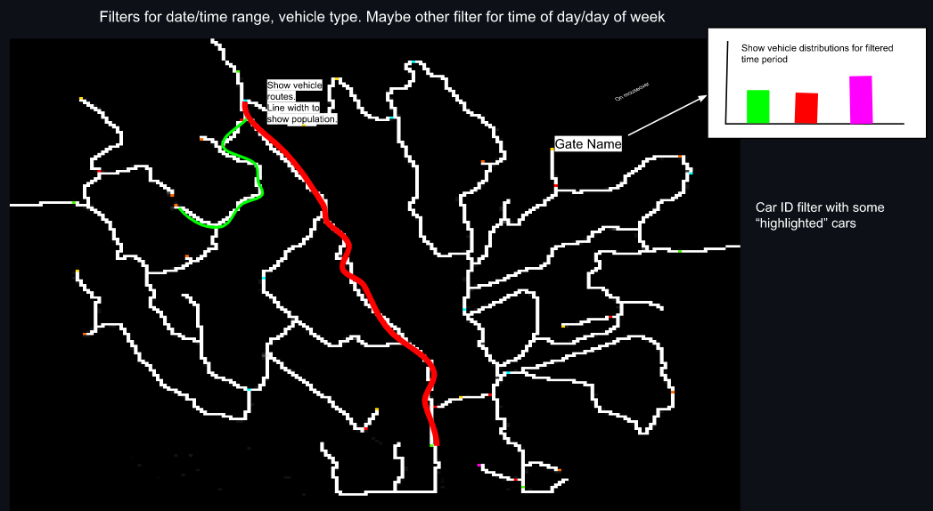
Sketch of D3 implementation

Slide 4
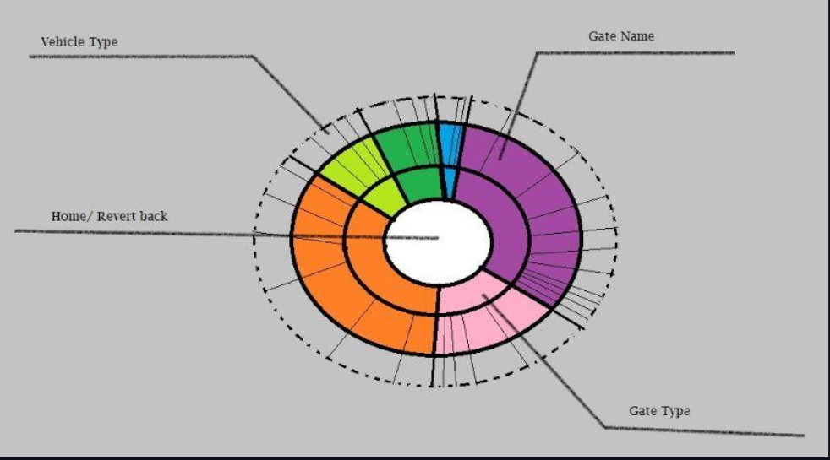
Sketch of D3 implementation

Slide 5
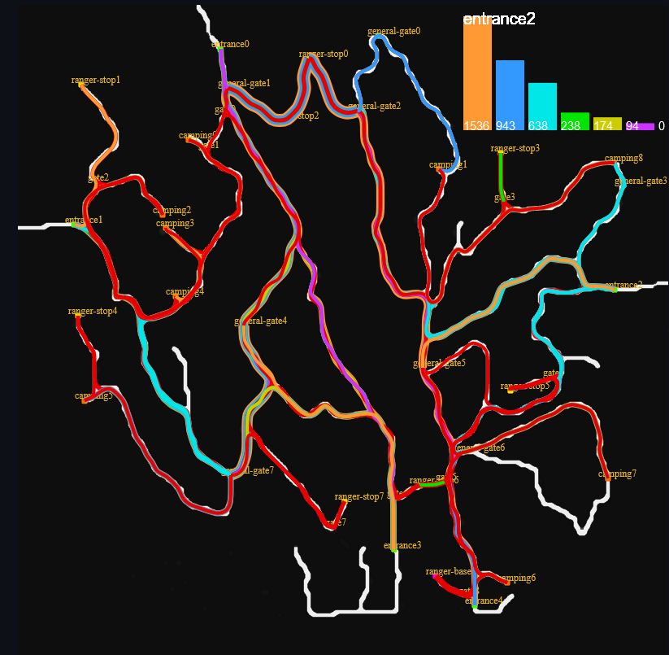
Feature Summarization:
Map visualization with vehicle routes.
Route width shows number of vehicles.
Filter by vehicle type and date range.
Mouse over gate names to show a bar graph of vehicle frequency.
Additional “real-time” simulation to visualize vehicle routes.
All visualizations are still accessible at: http://www.theverycenter.com/d3
(For some time)

Slide 6
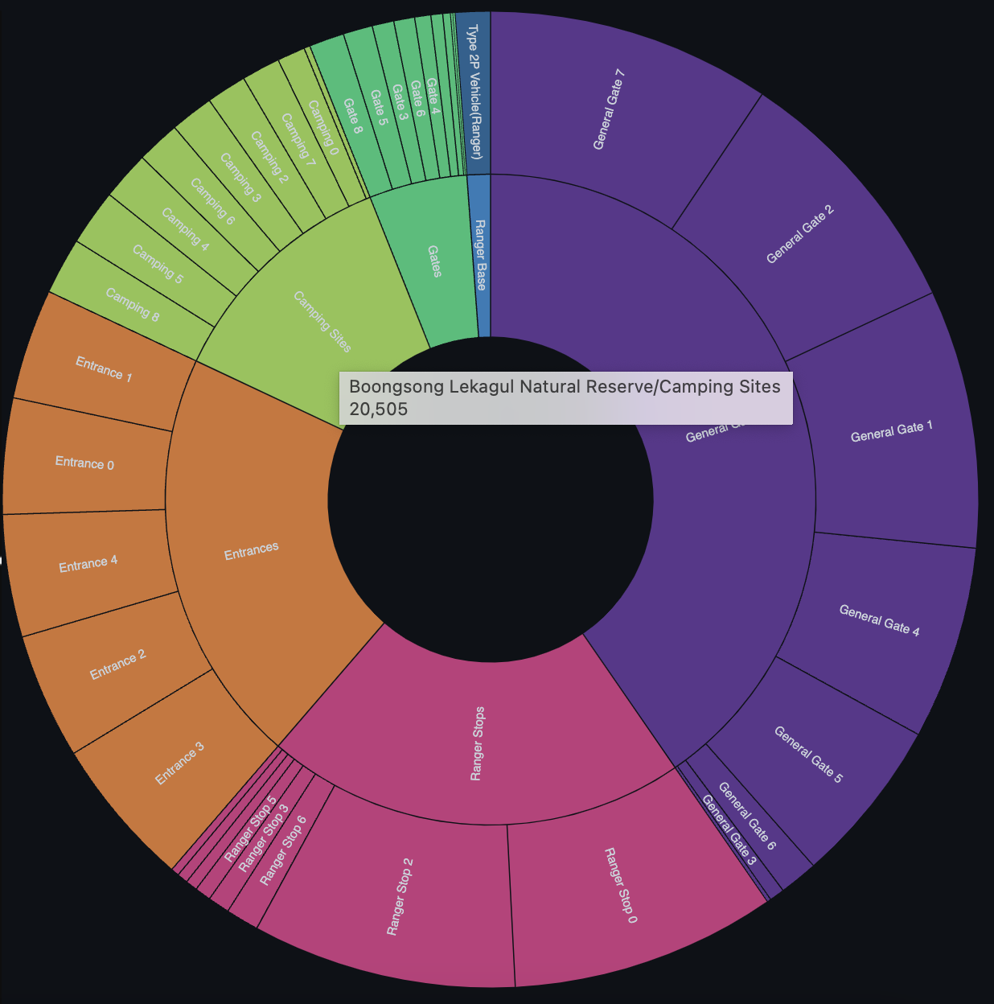
Feature Summarization:
Zoomable sunburst graph is divided into 4 hierarchical levels including the center.
Lekagul Natural reserve >> Type of Gate >> Gate Name >> Vehicle type
Every hierarchical circle’s segment width represents the volume of traffic through each segment.
The colors in the visualisation represents the different type of gates.
As we hover the mouse over the circle’s segments, we’re able to see the hierarchy as well as the volume of that specific segment.
By clicking each cell we can drill down and zoom in further cells to see volume insights.

Slide 7
Thank You!

